Slide 1
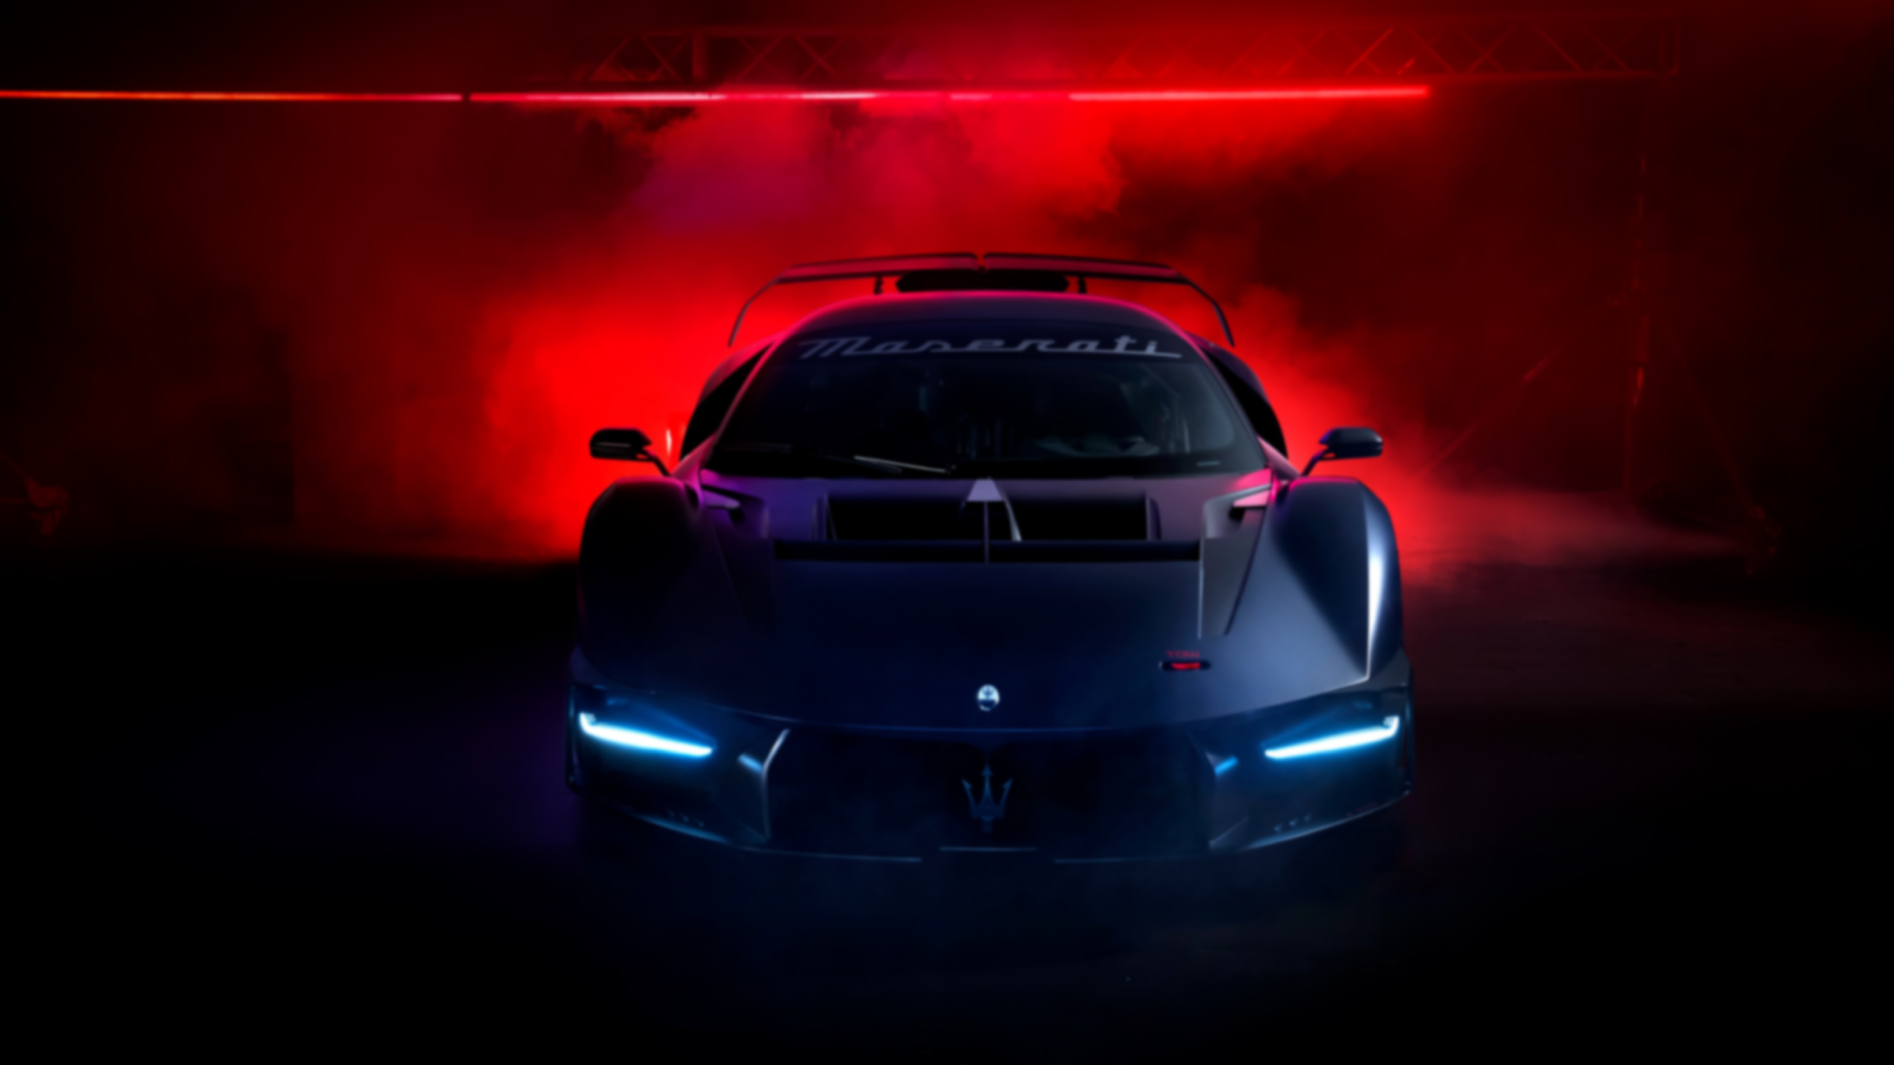
Analyzing the Impact of Car Features on Price & Profitability
Data Analyst | Raj Rathod

Slide 2

PROJECT OVERVIEW
The automotive industry has witnessed significant transformations driven by factors such as fuel efficiency, environmental concerns, and technological advancements. Amidst fierce competition and evolving consumer preferences, understanding the dynamics of consumer demand is paramount for manufacturers seeking sustained success.
This project aims to analyze the relationship between a car's features, market category, and pricing, and identify the key factors that affect profitability and consumer demand.
Given a comprehensive dataset, the key question posed by our client, a leading car manufacturer, is: How can we strategically set prices and develop products to enhance profitability while meeting consumer demand?

Slide 3
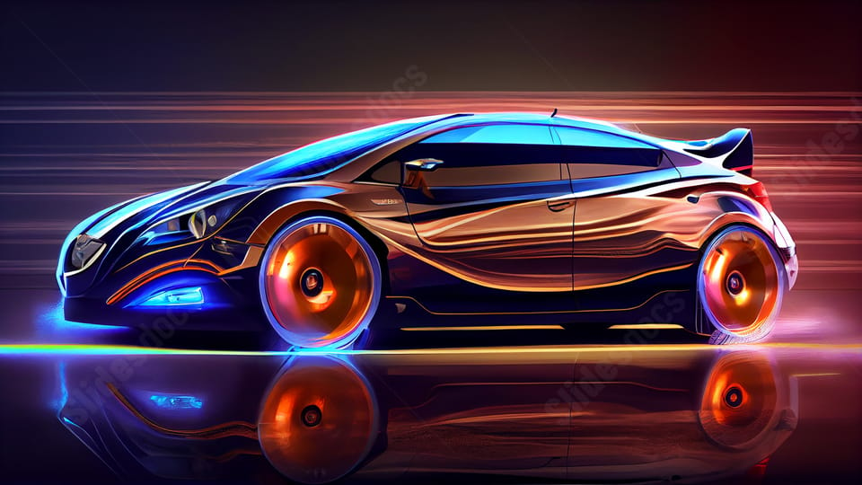
ANALYSIS APPROACH
To gain insights and address the problem, we will:
Explore trends in car features and pricing over time
Analyze the relationship between engine power, fuel efficiency, and pricing.
Identify the most important features influencing a car's price
Examine pricing variations across manufacturers and market categories.
Develop an interactive dashboard to visualize the findings.
By leveraging advanced Excel skills, regression analysis, and data visualization techniques, we aim to provide valuable insights to support informed pricing and product development decisions.
This presentation structure provides an overview of the project, outlines the problem statement, describes the dataset, and explains the analysis approach. It sets the stage for the subsequent slides, which will delve into the specific analyses, findings, and recommendations

Slide 4
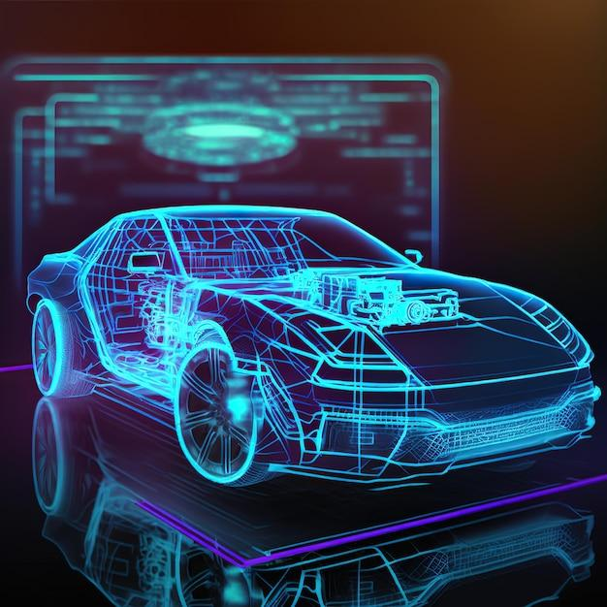


TECH STACK USED
Microsoft Excel 2020: Used for data analysis, manipulation, and visualization. Excel provides a wide range of functionalities for working with data, including formulas, charts, and pivot tables.
Microsoft PowerPoint: Utilized for creating presentations to showcase your analysis results, findings, and insights. PowerPoint offers tools for designing visually appealing slides and presenting information in a structured manner.

Slide 5
TASK 1 – POPULARITY OF CAR MODEL
Task 1.A: Create a pivot table that shows the number of car models in each market category and their corresponding popularity scores.
Insight : Top 20 Market Category Popularity of Cars
Market Category | Average of Popularity | Count of Model
Hatchback,Flex Fuel | 5657 | 7
Crossover,Flex Fuel,Performance | 5657 | 6
Flex Fuel,Diesel | 5657 | 16
Crossover,Luxury,Performance,Hybrid | 3916 | 2
Crossover,Factory Tuner,Luxury,Performance | 2607 | 5
Crossover,Performance | 2586 | 69
Crossover,Hybrid | 2563 | 42
Diesel,Luxury | 2416 | 47
Luxury,Performance,Hybrid | 2333 | 11
Flex Fuel | 2226 | 855
Crossover,Luxury,Diesel | 2196 | 33
Hatchback,Factory Tuner,Performance | 2174 | 21
Factory Tuner,Luxury,High-Performance | 2133 | 215
Hybrid | 2117 | 121
Hatchback,Hybrid | 2111 | 64
Crossover,Flex Fuel | 2074 | 64
Crossover,Hatchback,Performance | 2009 | 6
Crossover,Hatchback,Factory Tuner,Performance | 2009 | 6
Factory Tuner,High-Performance | 1966 | 104
Crossover,Factory Tuner,Luxury,High-Performance | 1823 | 26
Grand Total | 2262 | 1720

Slide 6
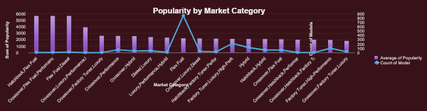
TASK 1 – POPULARITY OF CAR MODEL
Task 1.B: Create a combo chart that visualizes the relationship between market category and popularity.
Insight : The Most Popular Category of Cars is Hatchback, Flex Fuel/Diesel, Crossover and Luxury Cars.

Slide 7
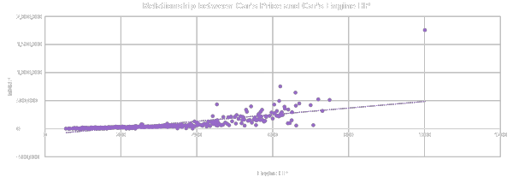
TASK 2 - RELATIONSHIP BETWEEN A CAR'S ENGINE POWER AND ITS PRICE?
Task 2: Create a scatter chart that plots engine power on the x-axis and price on the y-axis. Add a trendline to the chart to visualize the relationship between these variables.
Insight : Below is the Scatter Chart Plot which shows that as the Engine Power i.e HP Increases Prices also increases and can say that it is directly proportional.

Slide 8
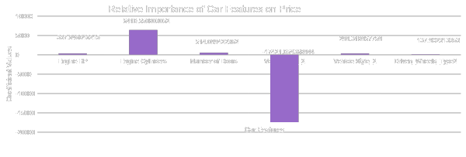
TASK 3 -WHICH FEATURES ARE MOST IMPORTANT FOR DETERMINING PRICE?
Task 3: Use regression analysis to identify the variables that have the strongest relationship with a car's price. Then create a bar chart that shows the coefficient values for each variable to visualize their relative importance.
Insight: The Features which is important with respect to price is Engine Cylinders, Engine HP (Power) and then Least is Vehicle Size. That is why Cars which are expensive like Sports Car are the Costliest.

Slide 9
TASK 4 - AVERAGE PRICE BY MANUFACTURER
Task 4.A: Create a pivot table that shows the average price of cars for each manufacturer.
Insight : Below is the List of Average Price of Cars of Each Manufacturer or Maker, where Bugatti is the Most Expensive Car Maker by Average Price.
Make (Manufacturer) | Average of MSRP
Bugatti | $17,57,224
Maybach | $5,46,222
Rolls-Royce | $3,51,131
Lamborghini | $3,31,567
Bentley | $2,47,169
McLaren | $2,39,805
Ferrari | $2,37,384
Spyker | $2,14,990
Aston Martin | $1,98,123
Maserati | $1,13,684
Porsche | $1,01,622
Mercedes-Benz | $72,135
Lotus | $68,377
Land Rover | $68,067
BMW | $62,163
Alfa Romeo | $61,600
Cadillac | $56,368
Audi | $54,574
Lexus | $47,549
Genesis | $46,617
Grand Total | $97,004

Slide 10
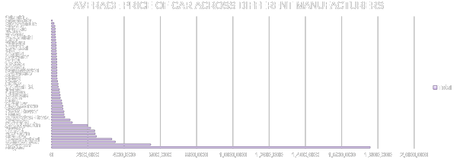
TASK 4 - AVERAGE PRICE BY MANUFACTURER
Task 4.B: Create a bar chart or a horizontal stacked bar chart that visualizes the relationship between manufacturer and average price.
Insight : As per the Analysis, Bugatti has the Most Expensive Average Price of Cars followed by Maybach, Rolls-Royce and Least expensive is Plymouth, Suzuki

Slide 11
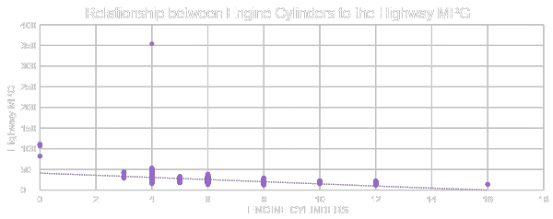
TASK 5- RELATIONSHIP BETWEEN FUEL EFFICIENCY AND ENGINE CYLINDERS
Task 5.A: Create a scatter plot with the number of cylinders on the x-axis and highway MPG on the y-axis. Then create a trendline on the scatter plot to visually estimate the slope of the relationship and assess its significance
Insight : As per the Analysis, When the Engine Cylinders are Higher then the Highway MPG is Lower because More Cylinders More Powerful Engine thus Lower MPG

Slide 12
TASK 5- RELATIONSHIP BETWEEN FUEL EFFICIENCY AND ENGINE CYLINDERS
Task 5.B: Calculate the correlation coefficient between the number of cylinders and highway MPG to quantify the strength and direction of the relationship.
Insight: Correlation Coefficient is {-0.614703148}

Slide 13
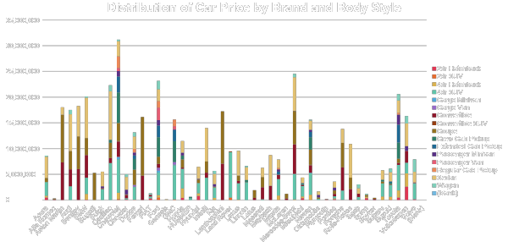
Task 1: How does the distribution of car prices vary by brand and body style?

Slide 14


Building the Dashboard

Slide 15
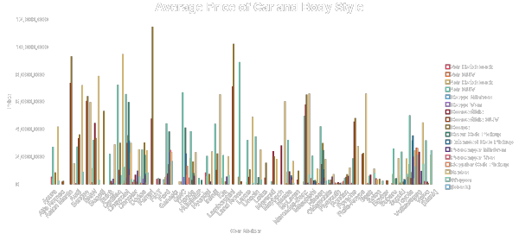
Task 2: Which car brands have the highest and lowest average MSRPs, and how does this vary by body style?

Slide 16
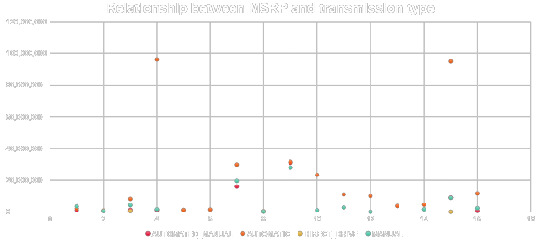
Task 3: How do the different feature such as transmission type affect the MSRP, and how does this vary by body style?

Slide 17
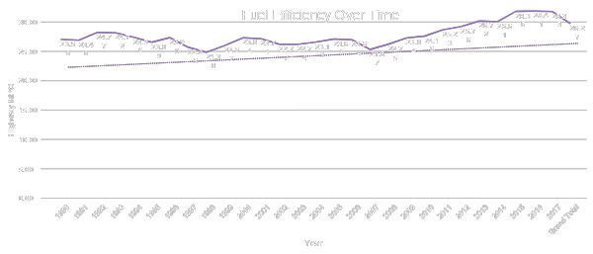
Task 4: How does the fuel efficiency of cars vary across different body styles and model years?

Slide 18
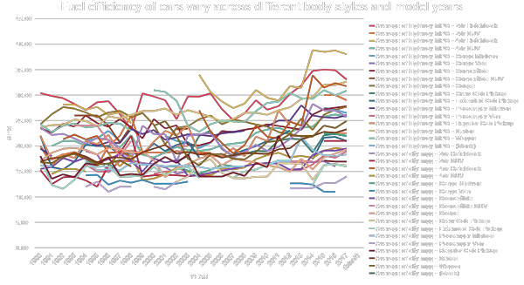

Slide 19
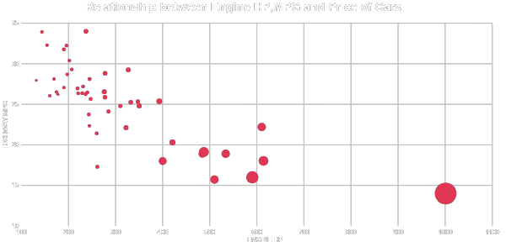
Task 5: How does the car's horsepower, MPG, and price vary across different Brands?

Slide 20
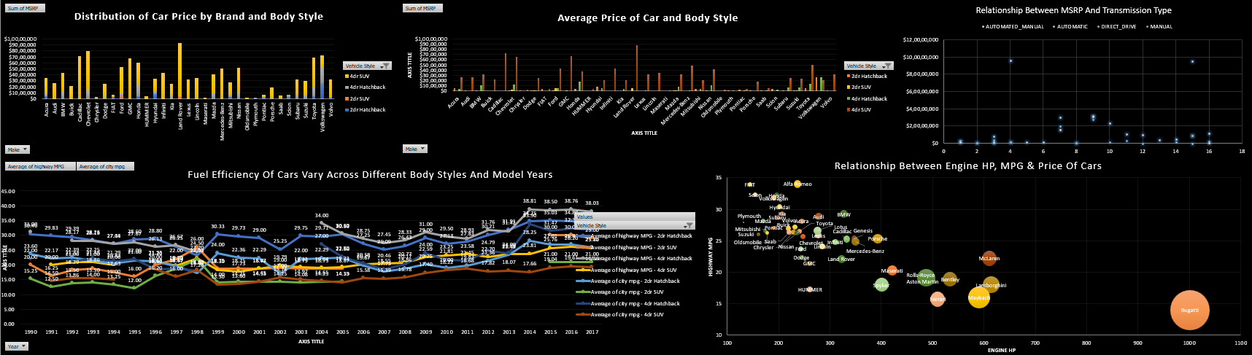
Dashboard

Slide 21
RESULT & CONCLUSION
Popular Car Categories: The most popular categories of cars based on our analysis are Hatchback, Flex Fuel/Diesel, Crossover, and Luxury Cars.
Price and Engine Power Relationship: There is a direct proportionality between engine power (Horse Power) and car prices. As engine power increases, so do prices, indicating that consumers are willing to pay more for higher performance.
Key Features Impacting Price: The most important features influencing car prices are Engine Cylinders and Engine HP (Power), followed by Vehicle Size. This explains why cars with expensive features like Sports Cars tend to be the costliest.
Average Price by Manufacturer: Bugatti emerges as the most expensive car maker with an average price of $1,757,224 USD, while Plymouth offers the cheapest cars with an average price of $3,297 USD.
Engine Cylinders and MPG: Analysis reveals that as engine cylinders increase, highway MPG decreases. This is because higher cylinder counts typically indicate more powerful engines, resulting in lower fuel efficiency.

Slide 22
Popular Car Category and Brand: Sedan is identified as the most popular car category, with Chevrolet being the most popular brand among consumers.
Fuel Efficiency: Passenger Vans exhibit the lowest fuel efficiency with an average MPG of 12.53, while 4dr Hatchback Cars show the highest fuel efficiency with an average MPG of 35.39.
Performance and Efficiency: Bugatti boasts the highest HP with the lowest MPG, making it the most costly car maker. Conversely, Fiat has the lowest HP, while Alfa Romeo achieves the highest highway MPG. Plymouth stands out as the cheapest car maker overall.
In conclusion, these insights offer valuable guidance for car manufacturers in understanding consumer preferences, optimizing pricing strategies, and focusing on key features to meet market demands effectively.

Slide 23
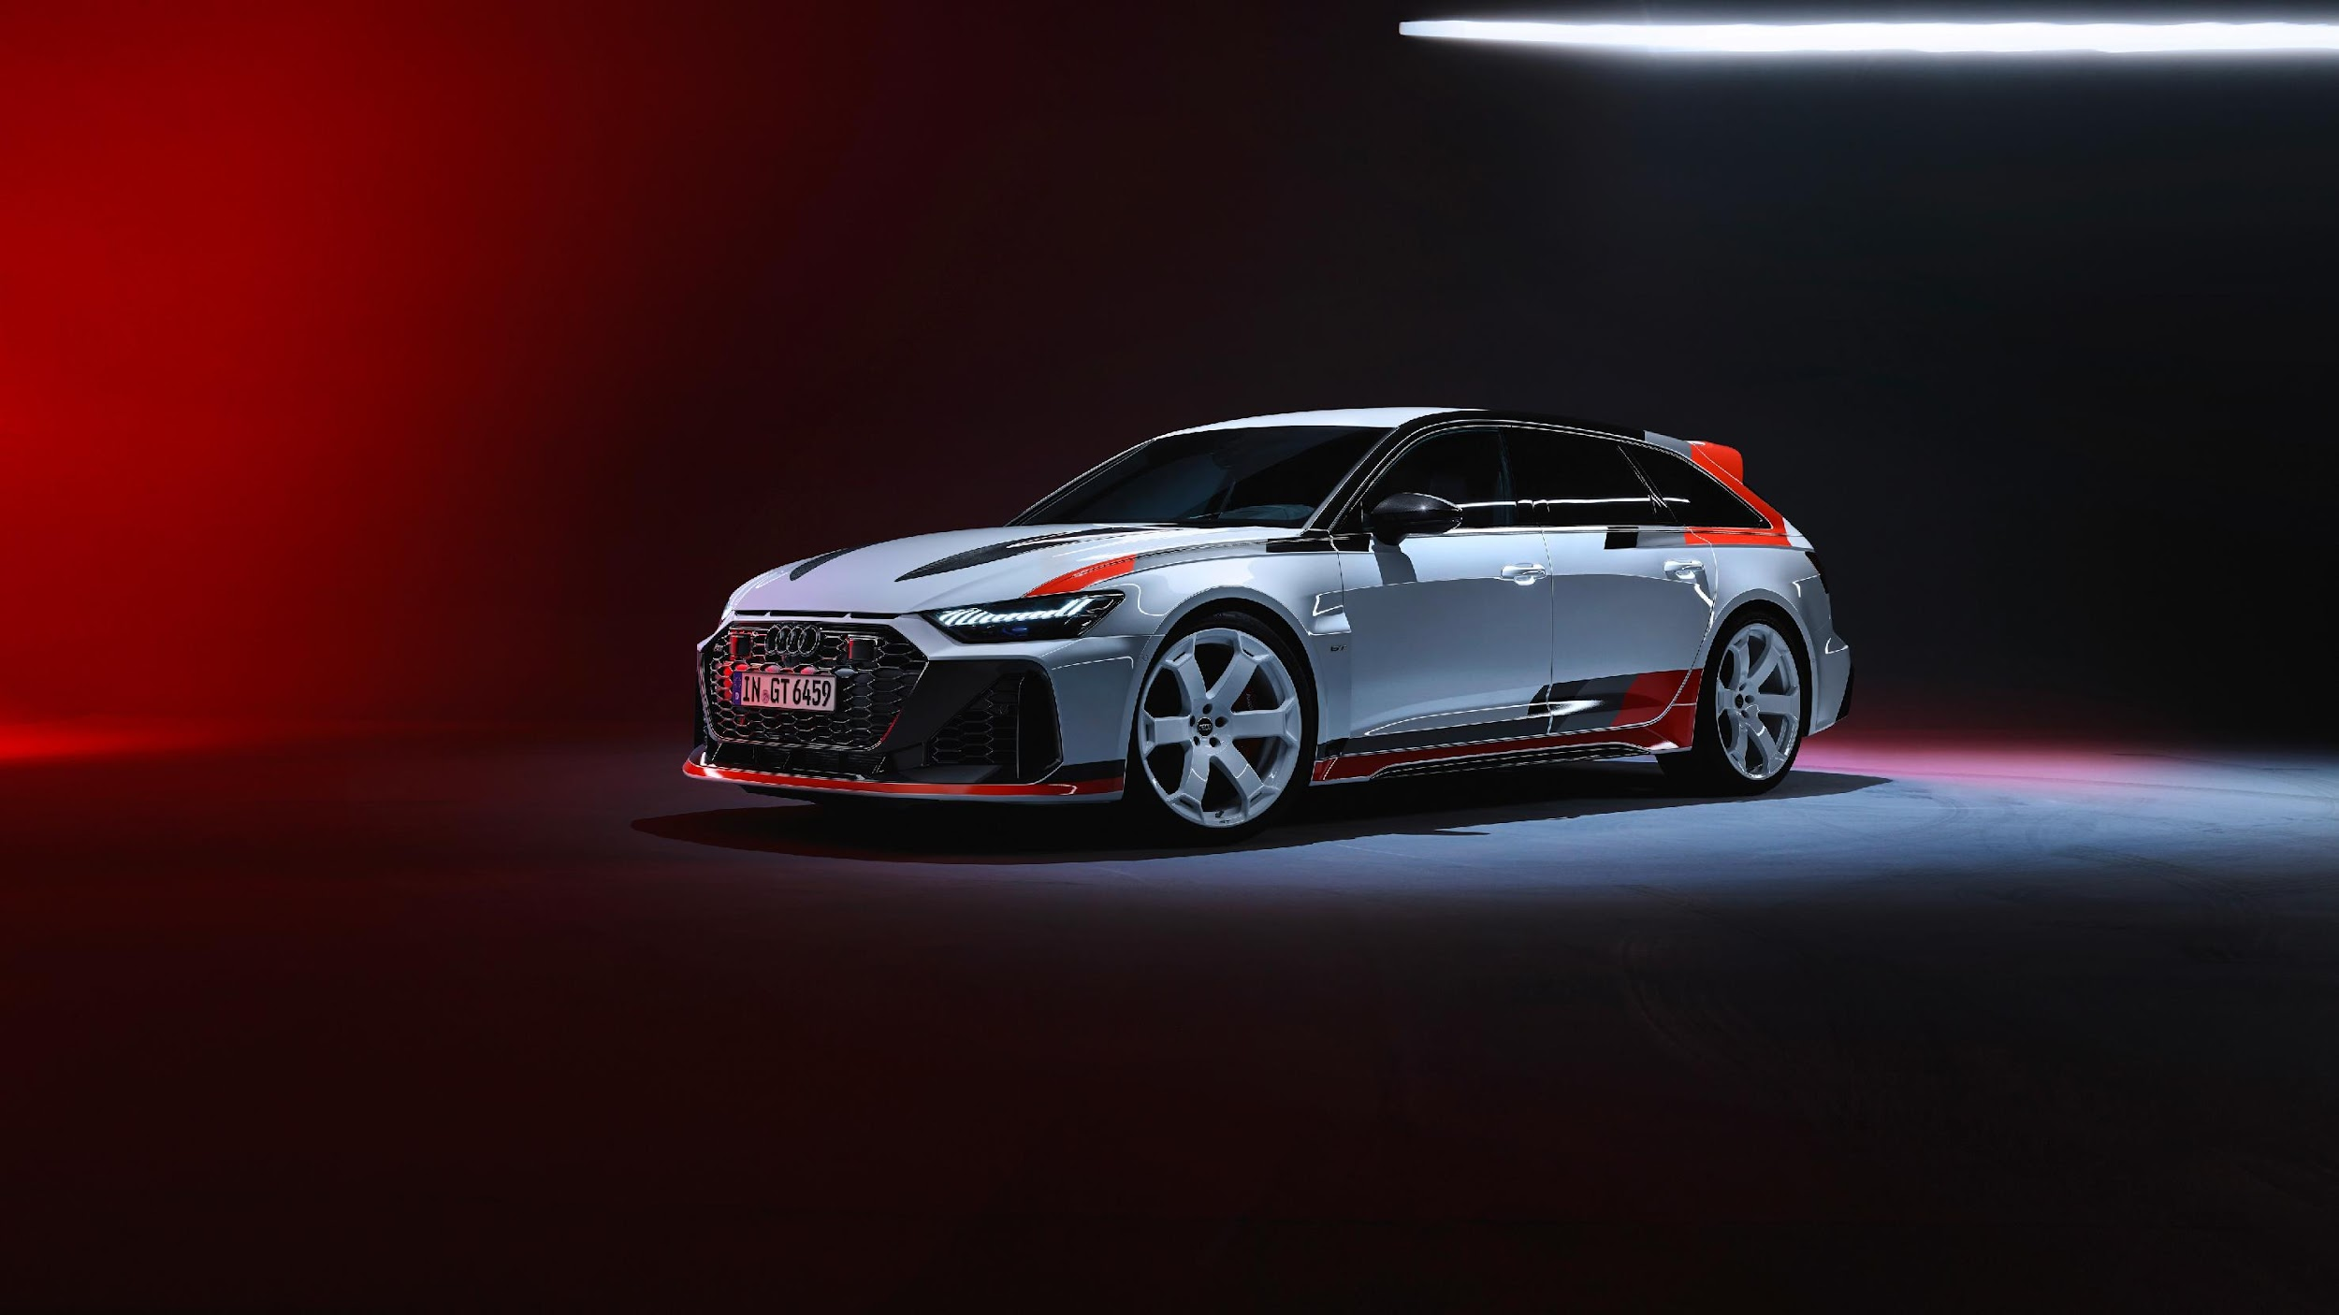
THANK YOU!
LinkedIn
Excel Workbook
Presentation Video

